Slide 1
Finite Element method
Joshua Davis – jodavis42@gmail.com

Slide 2
Deformable objects
Several different kinds of ways to model
Most popular is a spring mass aggregate
Stability issues especially with large stiffness constants
Unintuitive material properties
There are also continuum models
Approximates the volume of an object as a series of elements
Examples: FEM, BEM

Slide 3
FEM
Finite Element Method – What does this even mean?
FEM turns the continuum of an object into a series of finitely discretized elements.
We represent our object as a collection of smaller pieces (think triangle mesh)
While any shape can be used, tetrahedrons are the simple standard
So this means for our FEM:
The volume of our object is represented by a collection of tetrahedron

Slide 4
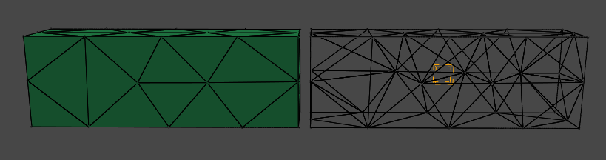
Tetrahedron?
The volume of any mesh can be represented as a collection of tetrahedron
Just like a triangle mesh can be used for any surface
Tetrahedralization is a complex process
Out of scope of this presentation
See references for tools

Slide 5
Formulation
It is important to grasp some formulation to understand FEM
FEM is stored like a mesh’s vertex and index buffer
Only with tetrahedrons
Picture here

Slide 6
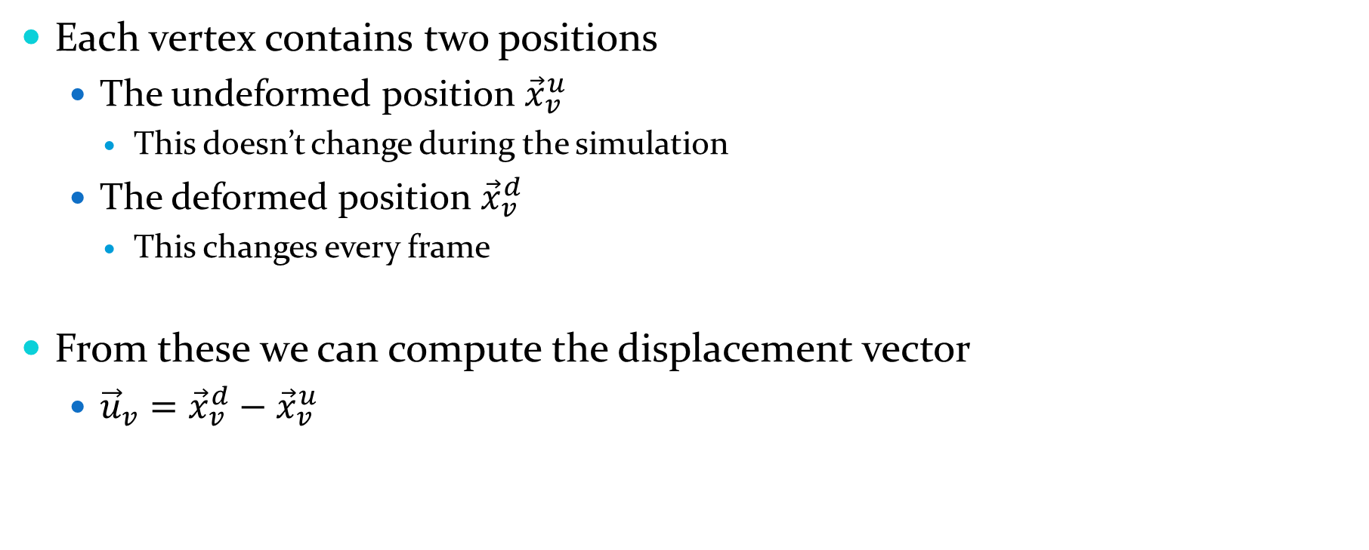
FEM Vertex
Each vertex contains two positions
The undeformed position ${\vec{x}}_{v}^{u}$
This doesn’t change during the simulation
The deformed position ${\vec{x}}_{v}^{d}$
This changes every frame
From these we can compute the displacement vector
${\vec{u}}_{v}={\vec{x}}_{v}^{d}−{\vec{x}}_{v}^{u}$

Slide 7
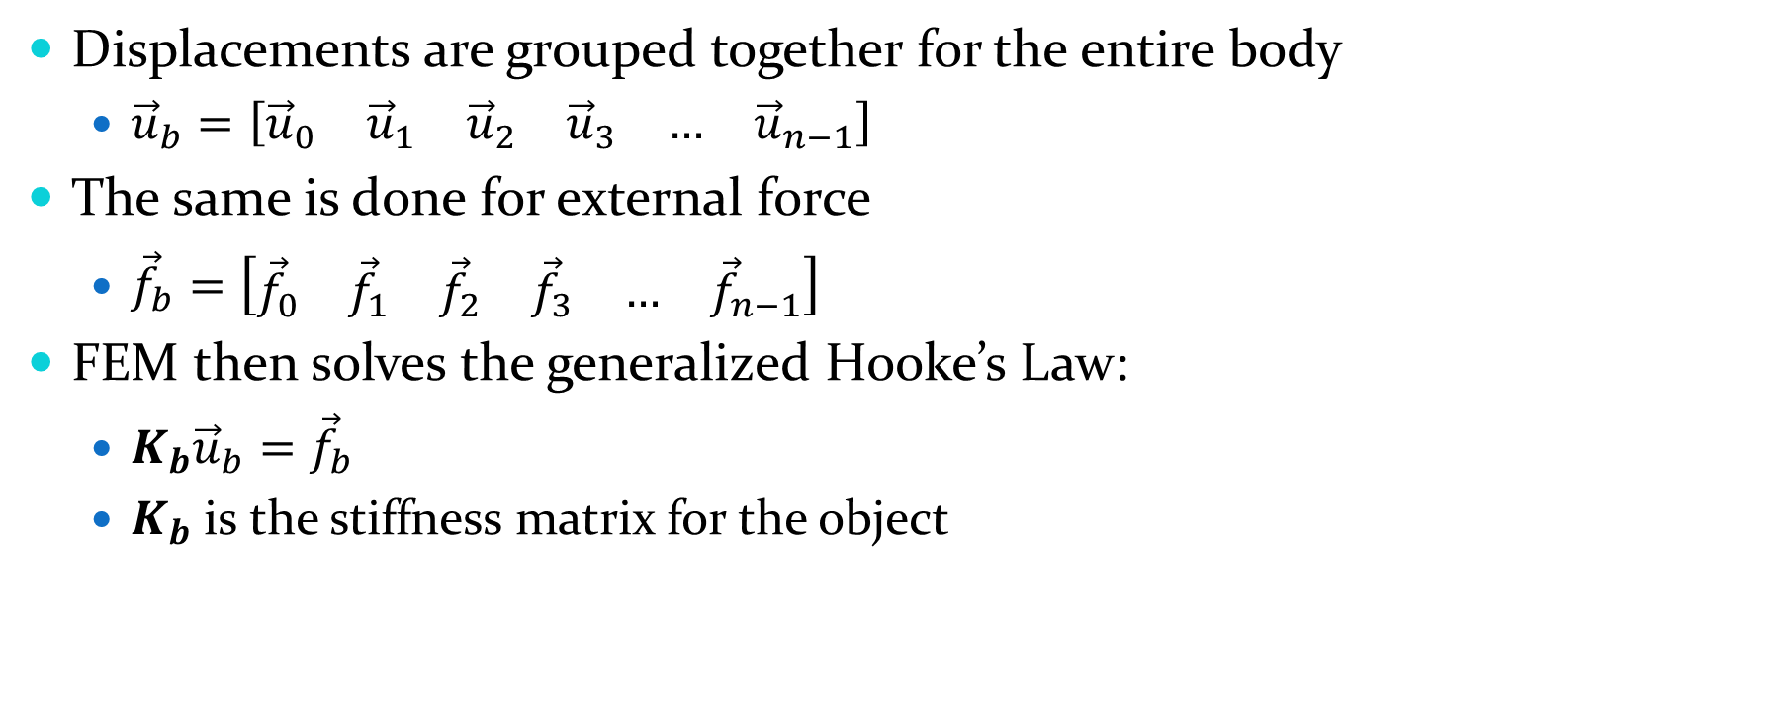
Displacements are grouped together for the entire body
${\vec{u}}_{b}=\left[\begin{matrix}{\vec{u}}_{0} & {\vec{u}}_{1} & {\vec{u}}_{2} & {\vec{u}}_{3} & … & {\vec{u}}_{n−1}\end{matrix}\right]$
The same is done for external force
${\vec{f}}_{b}=\left[\begin{matrix}{\vec{f}}_{0} & {\vec{f}}_{1} & {\vec{f}}_{2} & {\vec{f}}_{3} & … & {\vec{f}}_{n−1}\end{matrix}\right]$
FEM then solves the generalized Hooke’s Law:
$K_{b}{\vec{u}}_{b}={\vec{f}}_{b}$
$K_{b}$ is the stiffness matrix for the object

Slide 8
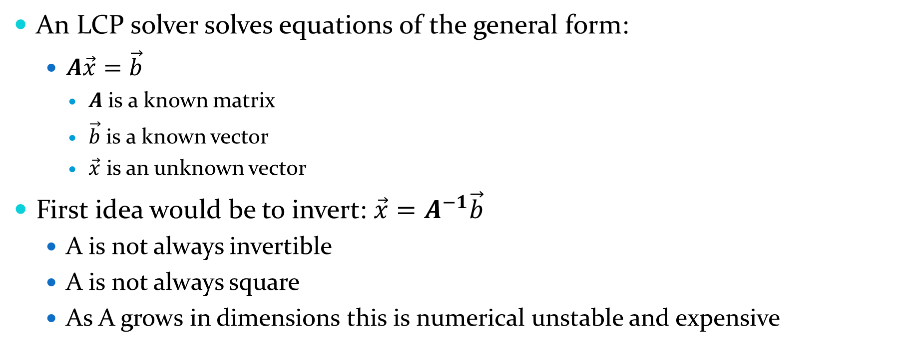
Linear Complimentarity Problem (LCP)
An LCP solver solves equations of the general form:
$A\vec{x}=\vec{b}$
$A$ is a known matrix
$\vec{b}$ is a known vector
$\vec{x}$ is an unknown vector
First idea would be to invert: $\vec{x}=A^{−1}\vec{b}$
A is not always invertible
A is not always square
As A grows in dimensions this is numerical unstable and expensive

Slide 9
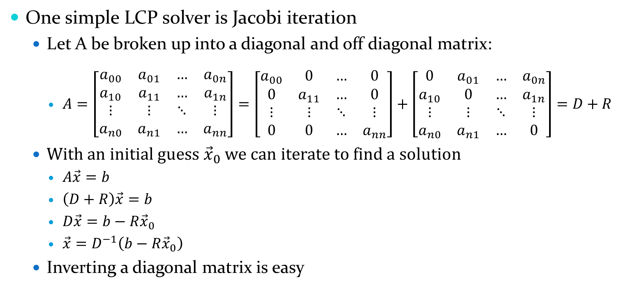
LCP - Example
One simple LCP solver is Jacobi iteration
Let A be broken up into a diagonal and off diagonal matrix:
$A=\left[\begin{matrix}a_{00} & a_{01} & … & a_{0n} \\ a_{10} & a_{11} & … & a_{1n} \\ ⋮ & ⋮ & ⋱ & ⋮ \\ a_{n0} & a_{n1} & … & a_{nn}\end{matrix}\right]=\left[\begin{matrix}a_{00} & 0 & … & 0 \\ 0 & a_{11} & … & 0 \\ ⋮ & ⋮ & ⋱ & ⋮ \\ 0 & 0 & … & a_{nn}\end{matrix}\right]+\left[\begin{matrix}0 & a_{01} & … & a_{0n} \\ a_{10} & 0 & … & a_{1n} \\ ⋮ & ⋮ & ⋱ & ⋮ \\ a_{n0} & a_{n1} & … & 0\end{matrix}\right]=D+R$
With an initial guess ${\vec{x}}_{0}$ we can iterate to find a solution
$A\vec{x}=b$
$\left(D+R\right)\vec{x}=b$
$D\vec{x}=b−R{\vec{x}}_{0}$
$\vec{x}=D^{−1}\left(b−R{\vec{x}}_{0}\right)$
Inverting a diagonal matrix is easy

Slide 10
LCP
Gauss-Seidel is another common LCP solver
Whenever I say iterate to get a better result, this is mathematically equivalent to Gauss-Seidel
FEM’s stiffness matrices are positive definite
This allows us to use some fancier solvers
Most commonly, Conjugate Gradient is used
See the references for a better paper than I could ever make explaining this

Slide 11
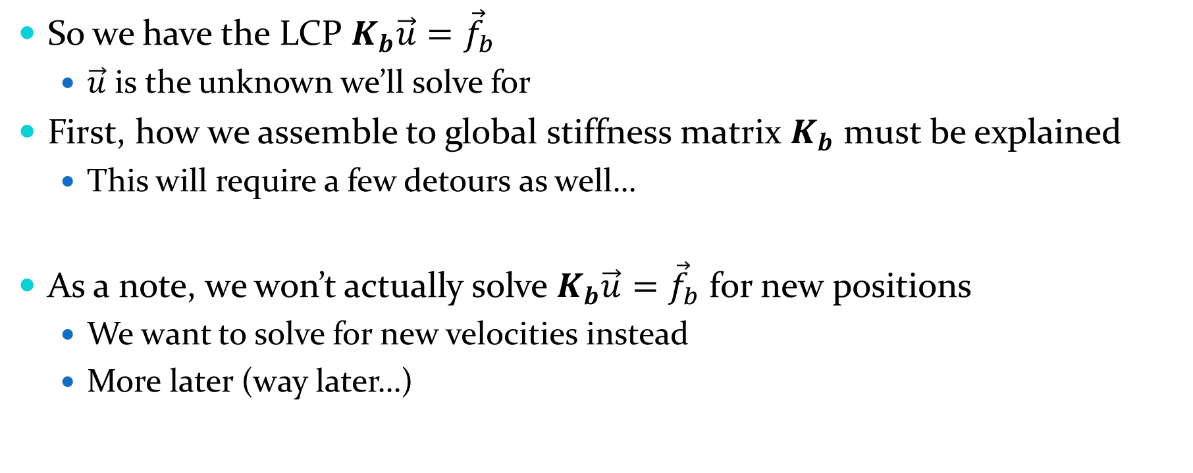
Back to FEM
So we have the LCP $K_{b}\vec{u}={\vec{f}}_{b}$
$\vec{u}$ is the unknown we’ll solve for
First, how we assemble to global stiffness matrix $K_{b}$ must be explained
This will require a few detours as well…
As a note, we won’t actually solve $K_{b}\vec{u}={\vec{f}}_{b}$ for new positions
We want to solve for new velocities instead
More later (way later…)

Slide 12
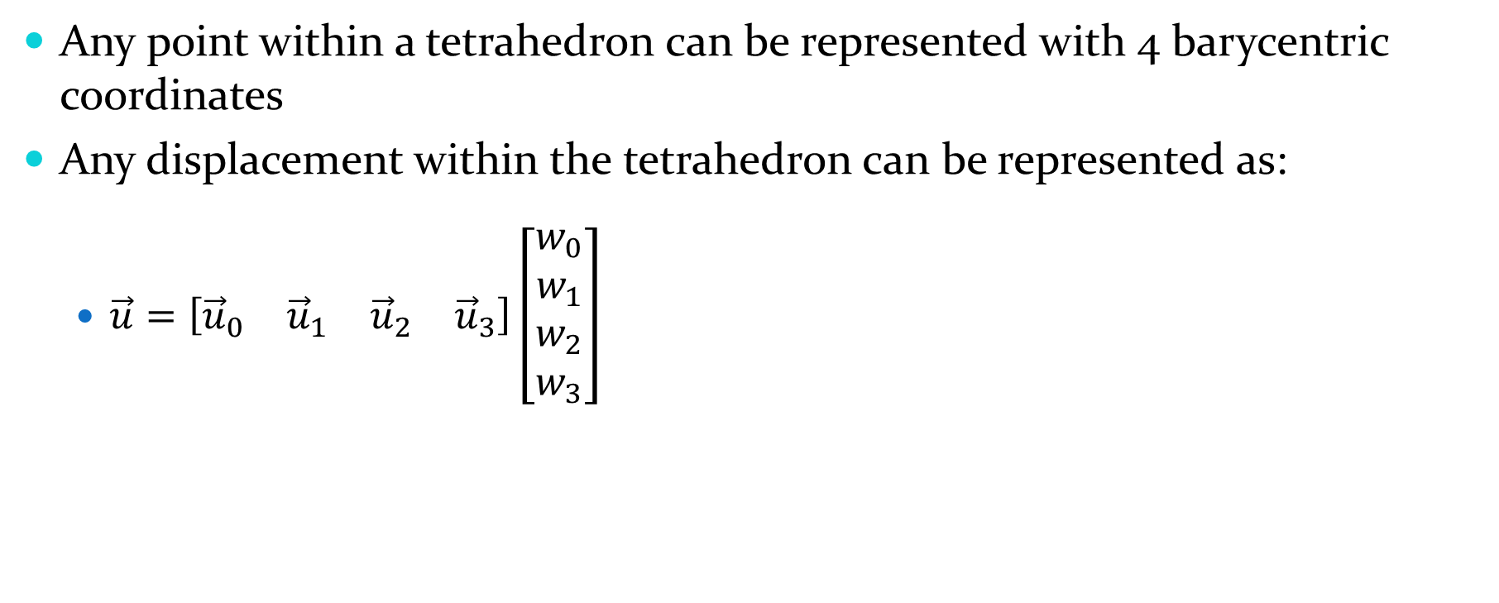
Barycentric coordinates
Any point within a tetrahedron can be represented with 4 barycentric coordinates
Any displacement within the tetrahedron can be represented as:
$\vec{u}=\left[\begin{matrix}{\vec{u}}_{0} & {\vec{u}}_{1} & {\vec{u}}_{2} & {\vec{u}}_{3}\end{matrix}\right]\left[\begin{matrix}w_{0} \\ w_{1} \\ w_{2} \\ w_{3}\end{matrix}\right]$

Slide 13
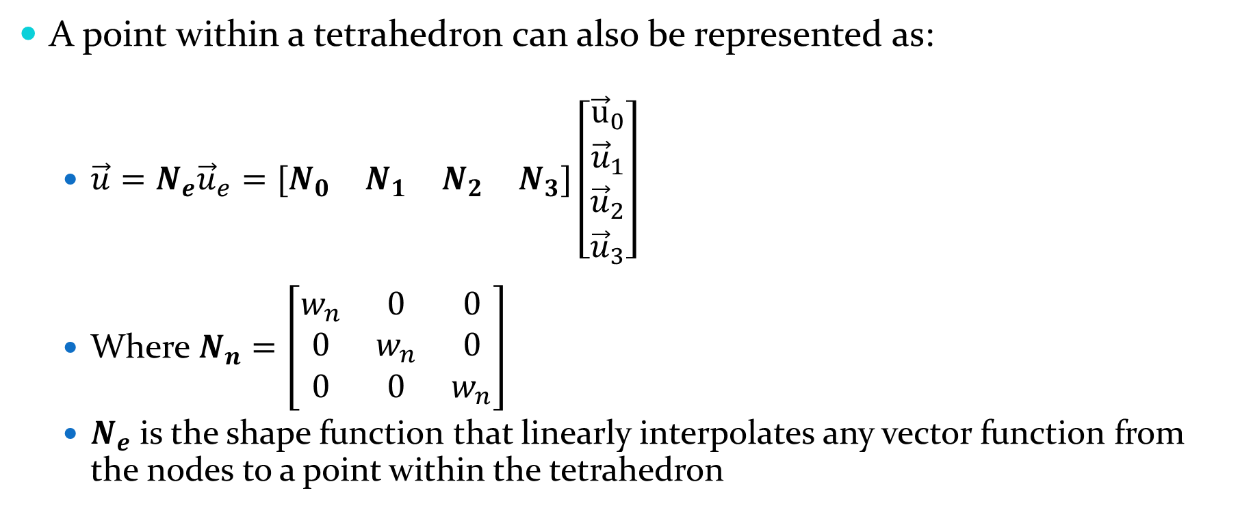
Shape function
A point within a tetrahedron can also be represented as:
$\vec{u}=N_{e}{\vec{u}}_{e}=[\begin{matrix}N_{0} & N_{1} & N_{2} & N_{3}]\left[\begin{matrix}{\vec{u}}_{0} \\ {\vec{u}}_{1} \\ {\vec{u}}_{2} \\ {\vec{u}}_{3}\end{matrix}\right]\end{matrix}$
Where $N_{n}=\left[\begin{matrix}w_{n} & 0 & 0 \\ 0 & w_{n} & 0 \\ 0 & 0 & w_{n}\end{matrix}\right]$
$N_{e}$ is the shape function that linearly interpolates any vector function from the nodes to a point within the tetrahedron

Slide 14
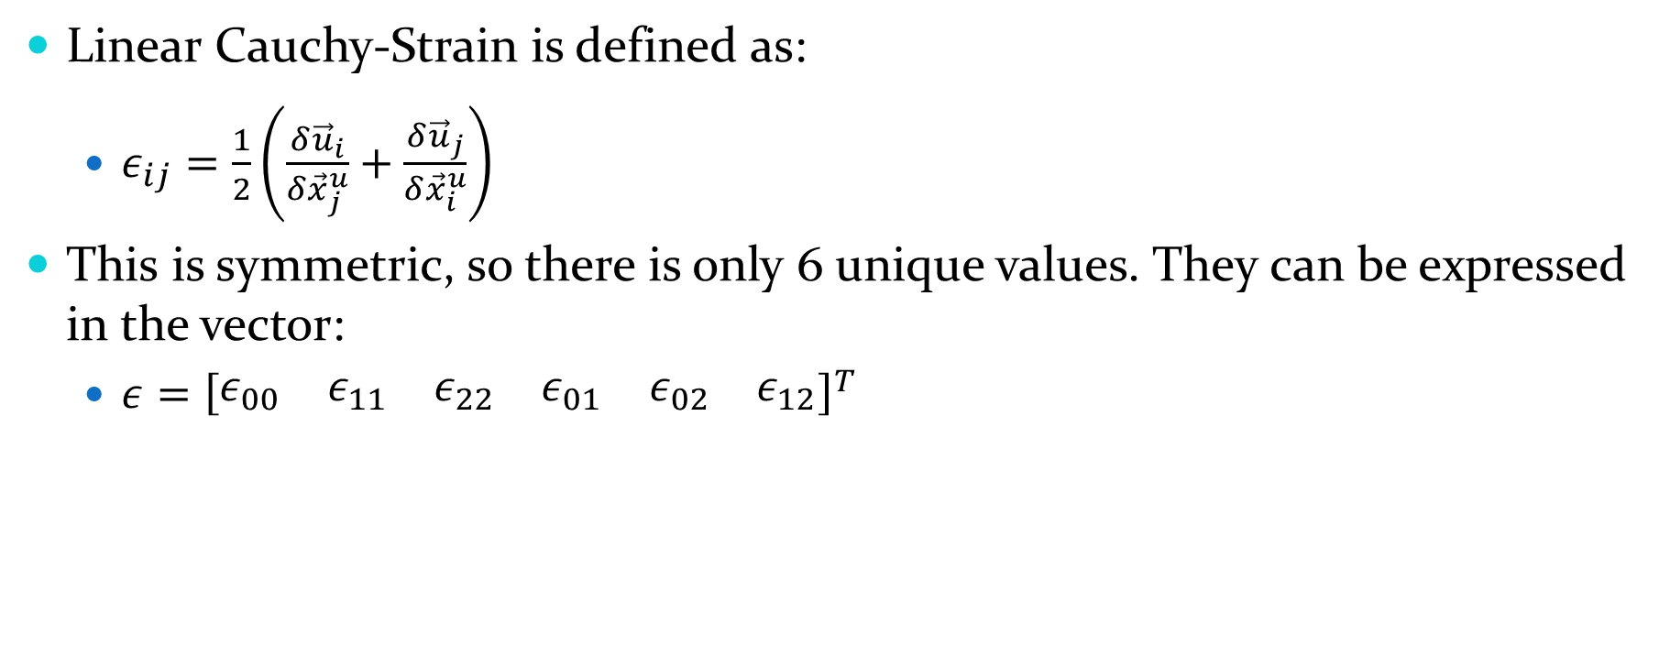
Strain
Linear Cauchy-Strain is defined as:
$ε_{ij}=\frac{1}{2}\left(\frac{δ{\vec{u}}_{i}}{δ{\vec{x}}_{j}^{u}}+\frac{δ{\vec{u}}_{j}}{δ{\vec{x}}_{i}^{u}}\right)$
This is symmetric, so there is only 6 unique values. They can be expressed in the vector:
$ε={\left[\begin{matrix}ε_{00} & ε_{11} & ε_{22} & ε_{01} & ε_{02} & ε_{12}\end{matrix}\right]}^{T}$

Slide 15

Strain
Lets look closer at $ε$
$ε=\left[\begin{matrix}\frac{δu_{x}}{δx} \\ \frac{δu_{y}}{δy} \\ \frac{δu_{z}}{δz} \\ \frac{δu_{x}}{δy}+\frac{δu_{y}}{δ_{x}} \\ \frac{δu_{x}}{δz}+\frac{δu_{z}}{δx} \\ \frac{δu_{y}}{δz}+\frac{δu_{z}}{δy}\end{matrix}\right]=\left[\begin{matrix}\frac{δ}{δx} & 0 & 0 \\ 0 & \frac{δ}{δy} & 0 \\ 0 & 0 & \frac{δ}{δz} \\ \frac{δ}{δy} & \frac{δ}{δx} & 0 \\ \frac{δ}{δz} & 0 & \frac{δ}{δx} \\ 0 & \frac{δ}{δz} & \frac{δ}{δy}\end{matrix}\right]\left[\begin{matrix}u_{x} \\ u_{y} \\ u_{z}\end{matrix}\right]=S{\vec{u}}_{v}$

Slide 16
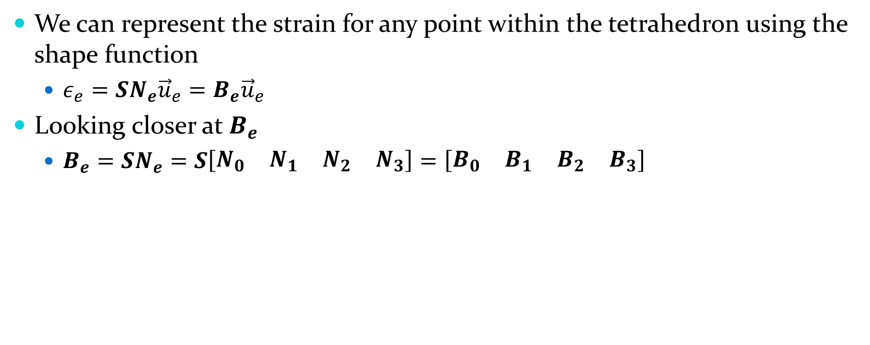
Element Strain
We can represent the strain for any point within the tetrahedron using the shape function
$ε_{e}=SN_{e}{\vec{u}}_{e}=B_{e}{\vec{u}}_{e}$
Looking closer at $B_{e}$
$B_{e}=SN_{e}=S\left[\begin{matrix}N_{0} & N_{1} & N_{2} & N_{3}\end{matrix}\right]=\left[\begin{matrix}B_{0} & B_{1} & B_{2} & B_{3}\end{matrix}\right]$

Slide 17

Element Strain Examined Closer
If we look even closer at one of these items, we can see:
$B_{n}=\left[\begin{matrix}\frac{δu_{x}}{δx} \\ \frac{δu_{y}}{δy} \\ \frac{δu_{z}}{δz} \\ \frac{δu_{x}}{δy}+\frac{δu_{y}}{δ_{x}} \\ \frac{δu_{x}}{δz}+\frac{δu_{z}}{δx} \\ \frac{δu_{y}}{δz}+\frac{δu_{z}}{δy}\end{matrix}\right]\left[\begin{matrix}w_{n} & 0 & 0 \\ 0 & w_{n} & 0 \\ 0 & 0 & w_{n}\end{matrix}\right]=\left[\begin{matrix}a & 0 & 0 \\ 0 & b & 0 \\ 0 & 0 & c \\ b & a & 0 \\ c & 0 & a \\ 0 & c & b\end{matrix}\right]$
Where $a=\frac{δw_{n}}{δx}$, $b=\frac{δw_{n}}{δy}$ and $c=\frac{δw_{n}}{δz}$

Slide 18

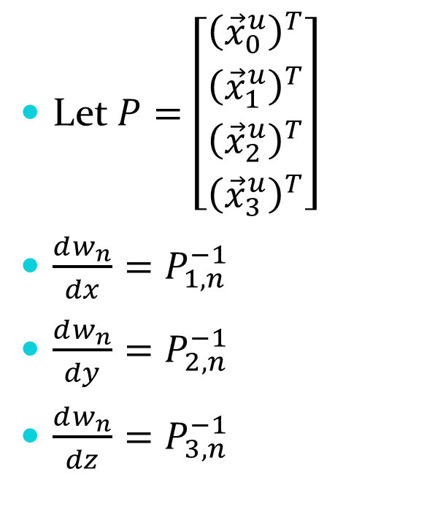
Partials
Let$P=\left[\begin{matrix}{\left({\vec{x}}_{0}^{u}\right)}^{T} \\ {\left({\vec{x}}_{1}^{u}\right)}^{T} \\ {\left({\vec{x}}_{2}^{u}\right)}^{T} \\ {\left({\vec{x}}_{3}^{u}\right)}^{T}\end{matrix}\right]$
$\frac{dw_{n}}{dx}=P_{1,n}^{−1}$
$\frac{dw_{n}}{dy}=P_{2,n}^{−1}$
$\frac{dw_{n}}{dz}=P_{3,n}^{−1}$
$P^{−1}=\left[\begin{matrix}? & \frac{dw_{0}}{dx} & \frac{dw_{0}}{dy} & \frac{dw_{0}}{dz} \\ ? & \frac{dw_{1}}{dx} & \frac{dw_{1}}{dy} & \frac{dw_{1}}{dz} \\ ? & \frac{dw_{2}}{dx} & \frac{dw_{2}}{dy} & \frac{dw_{2}}{dz} \\ ? & \frac{dw_{3}}{dx} & \frac{dw_{3}}{dy} & \frac{dw_{3}}{dz}\end{matrix}\right]$

Slide 19
Partials explained
These partials represent how pushing one vertex affects another
How does pushing vertex 0 affect vertex 1?
There is a more efficient way to calculate this then a matrix 4 inverse

Slide 20
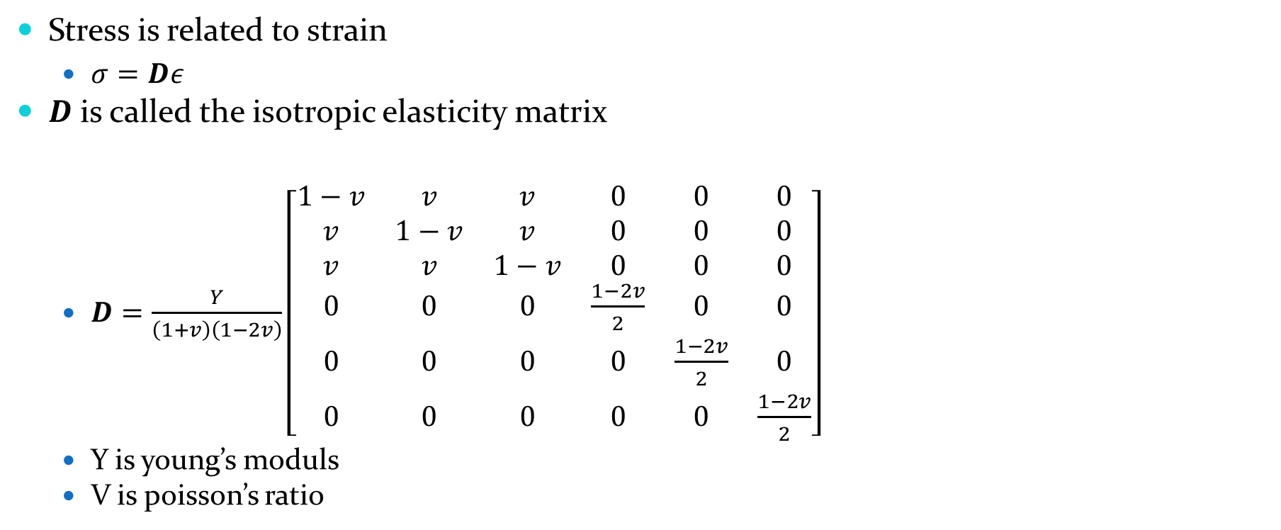
Stress
Stress is related to strain
$σ=Dε$
$D$ is called the isotropic elasticity matrix
$D=\frac{Y}{\left(1+v\right)\left(1−2v\right)}\left[\begin{matrix}1−v & v & v & 0 & 0 & 0 \\ v & 1−v & v & 0 & 0 & 0 \\ v & v & 1−v & 0 & 0 & 0 \\ 0 & 0 & 0 & \frac{1−2v}{2} & 0 & 0 \\ 0 & 0 & 0 & 0 & \frac{1−2v}{2} & 0 \\ 0 & 0 & 0 & 0 & 0 & \frac{1−2v}{2}\end{matrix}\right]$
Y is young’s moduls
V is poisson’s ratio

Slide 21
Material properties
FEM uses real world material properties
Young’s moduls (Y)
Measures the instretchability of an object
Steel - 200,000,000 Pa
Cork - 32,000
http://en.wikipedia.org/wiki/Young%27s_modulus
Poisson’s ratio (v)
Describes how much a material contracts when stretching
Valid ranges [-1,1/2]

Slide 22
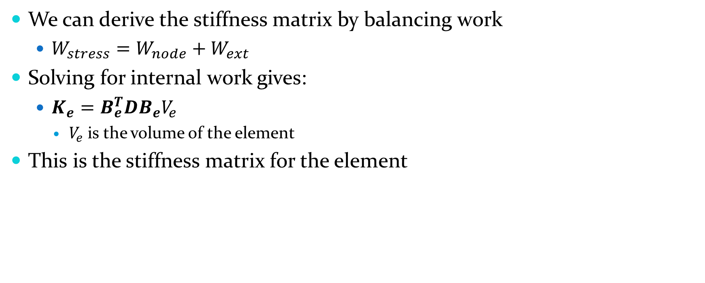
Balancing work
We can derive the stiffness matrix by balancing work
$W_{stress}=W_{node}+W_{ext}$
Solving for internal work gives:
$K_{e}=B_{e}^{T}DB_{e}V_{e}$
$V_{e}$ is the volume of the element
This is the stiffness matrix for the element

Slide 23
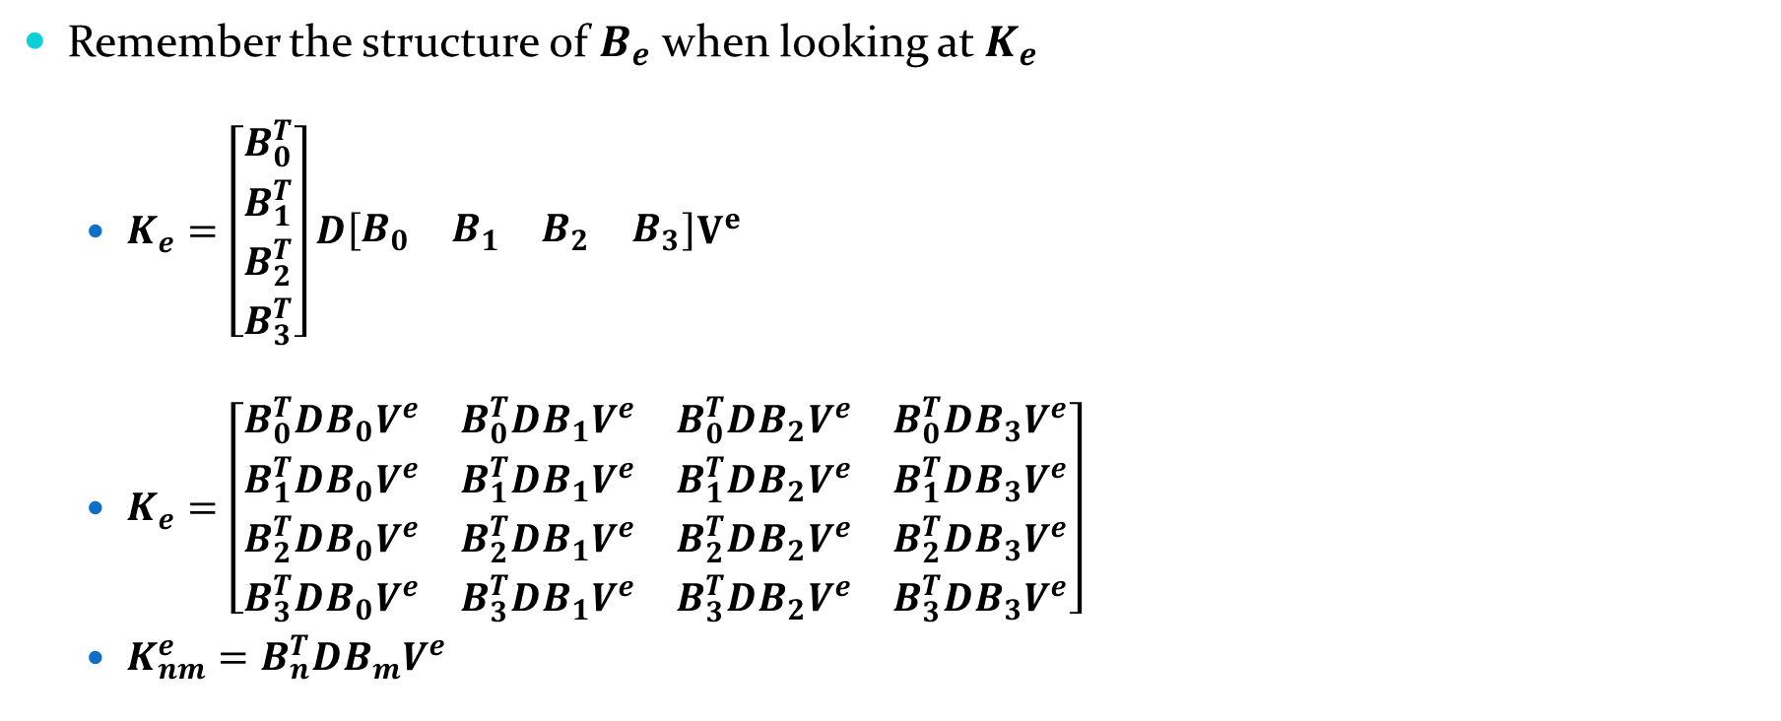
Evaluating K
Remember the structure of $B_{e}$ when looking at $K_{e}$
$K_{e}=\left[\begin{matrix}B_{0}^{T} \\ B_{1}^{T} \\ B_{2}^{T} \\ B_{3}^{T}\end{matrix}\right]D\left[\begin{matrix}B_{0} & B_{1} & B_{2} & B_{3}\end{matrix}\right]V^{e}$
$K_{e}=\left[\begin{matrix}B_{0}^{T}DB_{0}V^{e} & B_{0}^{T}DB_{1}V^{e} & B_{0}^{T}DB_{2}V^{e} & B_{0}^{T}DB_{3}V^{e} \\ B_{1}^{T}DB_{0}V^{e} & B_{1}^{T}DB_{1}V^{e} & B_{1}^{T}DB_{2}V^{e} & B_{1}^{T}DB_{3}V^{e} \\ B_{2}^{T}DB_{0}V^{e} & B_{2}^{T}DB_{1}V^{e} & B_{2}^{T}DB_{2}V^{e} & B_{2}^{T}DB_{3}V^{e} \\ B_{3}^{T}DB_{0}V^{e} & B_{3}^{T}DB_{1}V^{e} & B_{3}^{T}DB_{2}V^{e} & B_{3}^{T}DB_{3}V^{e}\end{matrix}\right]$
$K_{nm}^{e}=B_{n}^{T}DB_{m}V^{e}$

Slide 24

Efficiency of K
Note that $K$ is symmetric
That is ${\left(K_{ij}^{e}\right)}^{T}=K_{ji}^{e}$
Further looking into these elements we can rewrite D
$D=\left[\begin{matrix}D_{0} & D_{1} & D_{1} & 0 & 0 & 0 \\ D_{1} & D_{0} & D_{1} & 0 & 0 & 0 \\ D_{1} & D_{1} & D_{0} & 0 & 0 & 0 \\ 0 & 0 & 0 & D_{2} & 0 & 0 \\ 0 & 0 & 0 & 0 & D_{2} & 0 \\ 0 & 0 & 0 & 0 & 0 & D_{2}\end{matrix}\right]$
Where
$D_{0}=\frac{Y\left(1−v\right)}{\left(1+v\right)\left(1−2v\right)}$
$D_{1}=\frac{Yv}{\left(1+v\right)\left(1−2v\right)}$
$D_{2}=\frac{Y(1−2v)}{2\left(1+v\right)\left(1−2v\right)}$

Slide 25
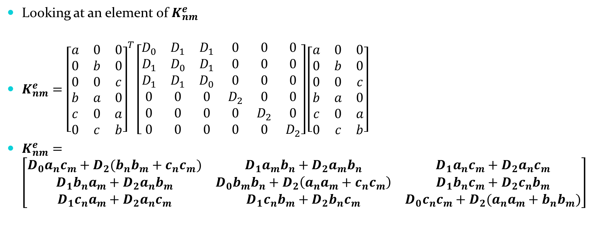
Efficiency of K
Looking at an element of $K_{nm}^{e}$
$K_{nm}^{e}={\left[\begin{matrix}a & 0 & 0 \\ 0 & b & 0 \\ 0 & 0 & c \\ b & a & 0 \\ c & 0 & a \\ 0 & c & b\end{matrix}\right]}^{T}\left[\begin{matrix}D_{0} & D_{1} & D_{1} & 0 & 0 & 0 \\ D_{1} & D_{0} & D_{1} & 0 & 0 & 0 \\ D_{1} & D_{1} & D_{0} & 0 & 0 & 0 \\ 0 & 0 & 0 & D_{2} & 0 & 0 \\ 0 & 0 & 0 & 0 & D_{2} & 0 \\ 0 & 0 & 0 & 0 & 0 & D_{2}\end{matrix}\right]\left[\begin{matrix}a & 0 & 0 \\ 0 & b & 0 \\ 0 & 0 & c \\ b & a & 0 \\ c & 0 & a \\ 0 & c & b\end{matrix}\right]$
$K_{nm}^{e}=\left[\begin{matrix}D_{0}a_{n}c_{m}+D_{2}(b_{n}b_{m}+c_{n}c_{m}) & D_{1}a_{m}b_{n}+D_{2}a_{m}b_{n} & D_{1}a_{n}c_{m}+D_{2}a_{n}c_{m} \\ D_{1}b_{n}a_{m}+D_{2}a_{n}b_{m} & D_{0}b_{m}b_{n}+D_{2}\left(a_{n}a_{m}+c_{n}c_{m}\right) & D_{1}b_{n}c_{m}+D_{2}c_{n}b_{m} \\ D_{1}c_{n}a_{m}+D_{2}a_{n}c_{m} & D_{1}c_{n}b_{m}+D_{2}b_{n}c_{m} & D_{0}c_{n}c_{m}+D_{2}(a_{n}a_{m}+b_{n}b_{m})\end{matrix}\right]$

Slide 26
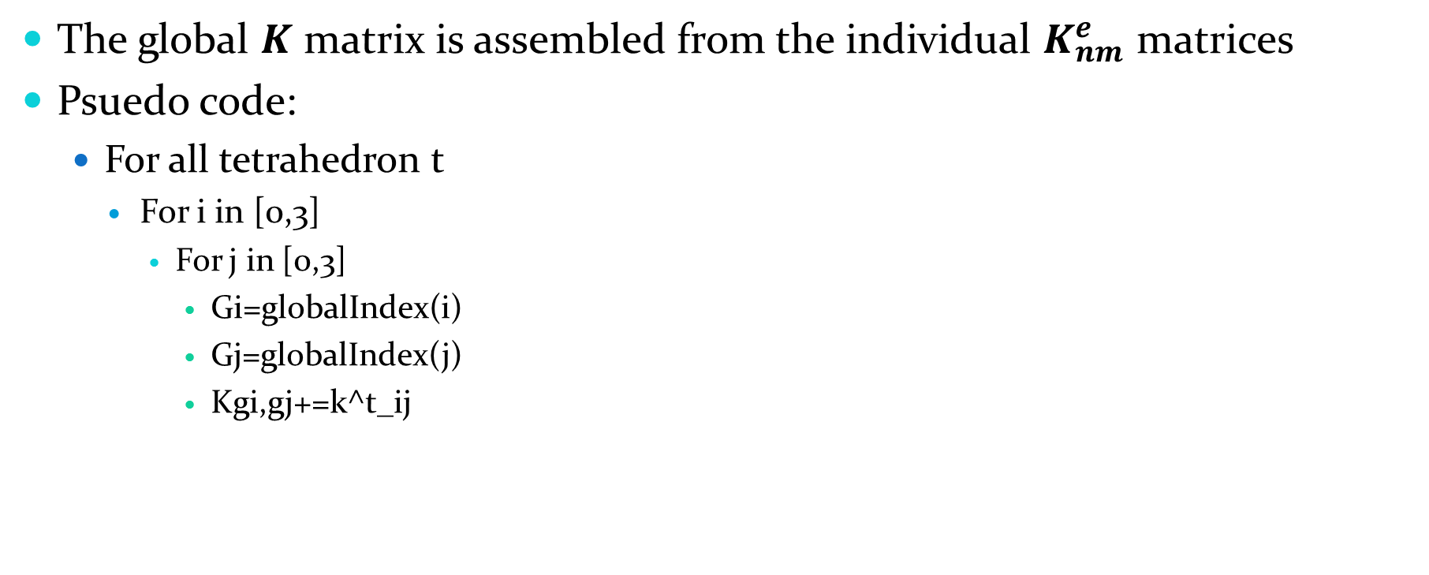
Assembling K
The global $K$ matrix is assembled from the individual $K_{nm}^{e}$ matrices
Psuedo code:
For all tetrahedron t
For i in [0,3]
For j in [0,3]
Gi=globalIndex(i)
Gj=globalIndex(j)
Kgi,gj+=k^t_ij

Slide 27
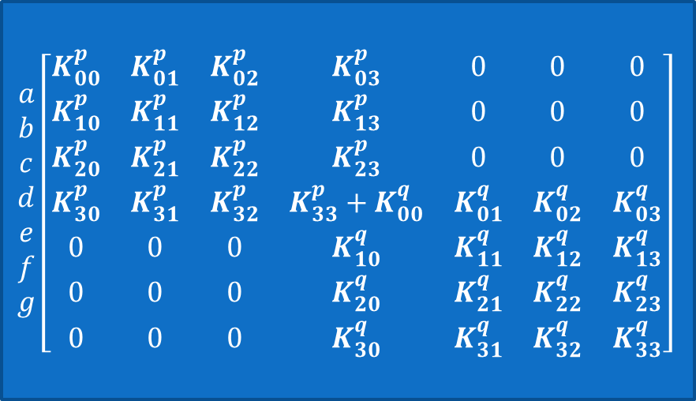
Assembling K – Example 1
B [1,]
e [,1]
p[abcd]
q[defg]
D [3,0]
g [,3]
A [0,]
C [2,]
f [,2]
$$\begin{matrix}a \\ b \\ c \\ d \\ e \\ f \\ g\end{matrix}\left[\begin{matrix}K_{00}^{p} & K_{01}^{p} & K_{02}^{p} & K_{03}^{p} & 0 & 0 & 0 \\ K_{10}^{p} & K_{11}^{p} & K_{12}^{p} & K_{13}^{p} & 0 & 0 & 0 \\ K_{20}^{p} & K_{21}^{p} & K_{22}^{p} & K_{23}^{p} & 0 & 0 & 0 \\ K_{30}^{p} & K_{31}^{p} & K_{32}^{p} & K_{33}^{p}+K_{00}^{q} & K_{01}^{q} & K_{02}^{q} & K_{03}^{q} \\ 0 & 0 & 0 & K_{10}^{q} & K_{11}^{q} & K_{12}^{q} & K_{13}^{q} \\ 0 & 0 & 0 & K_{20}^{q} & K_{21}^{q} & K_{22}^{q} & K_{23}^{q} \\ 0 & 0 & 0 & K_{30}^{q} & K_{31}^{q} & K_{32}^{q} & K_{33}^{q}\end{matrix}\right]$$

Slide 28
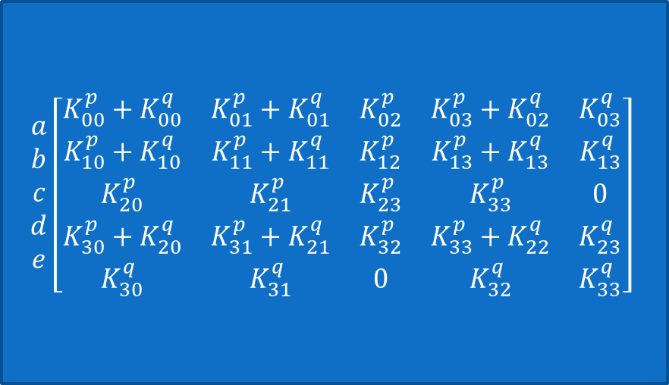
Assembling K – Example 2
A [0,0]
p[abcd]
q[abde]
B [1,1]
E [,3]
C [2,]
D [3,2]
$$\begin{matrix}a \\ b \\ c \\ d \\ e\end{matrix}\left[\begin{matrix}K_{00}^{p}+K_{00}^{q} & K_{01}^{p}+K_{01}^{q} & K_{02}^{p} & K_{03}^{p}+K_{02}^{q} & K_{03}^{q} \\ K_{10}^{p}+K_{10}^{q} & K_{11}^{p}+K_{11}^{q} & K_{12}^{p} & K_{13}^{p}+K_{13}^{q} & K_{13}^{q} \\ K_{20}^{p} & K_{21}^{p} & K_{23}^{p} & K_{33}^{p} & 0 \\ K_{30}^{p}+K_{20}^{q} & K_{31}^{p}+K_{21}^{q} & K_{32}^{p} & K_{33}^{p}+K_{22}^{q} & K_{23}^{q} \\ K_{30}^{q} & K_{31}^{q} & 0 & K_{32}^{q} & K_{33}^{q}\end{matrix}\right]$$

Slide 29

Inertia and Damping
The current model is static deformation
No mass
Can solve with mass and damping as follows
$M\vec{a}+C\vec{v}+K\left({\vec{x}}^{d}−{\vec{x}}^{u}\right)={\vec{f}}_{ext}$

